Slide 1
One title in two different related records
Using the 774 Constituent Unit Entry field
Yoel Kortick

Slide 2
Agenda
  Introduction
  The works in which the short story exists
  Catalog the short story and link to related records
  The job "MMS - Build Record Relations"
  The related records in Alma
  The related records in discovery (Primo)
2

Slide 3
Introduction

Slide 4
Introduction
In the example here the institution is cataloging short story "On account of a hat" by author "Sholom Aleichem"
This short story appears in two different works, both of which are held by the library:
Sociology through literature : an introductory reader / edited by Lewis A. Coser.
  System control number (OCoLC)965138
Selected stories of Sholom Aleichem / with an introduction by Alfred Kazin. \
  System control number (OCoLC)709205

Slide 5
Introduction
The institution wants to allow both the staff user in Alma as well as the end user in discovery (in the case here Primo) to be able to find the record for “On account of a hat” and have the user clearly see where the short story exists.
We will be using here the 774 Constituent Unit Entry field, through we could also use the 773 Host Item Entry field

Slide 6
The works in which the short story exists

Slide 7
The works in which the short story exists
As stated in the introduction, the short story “On account of a hat” exists in these two works:
Sociology through literature : an introductory reader / edited by Lewis A. Coser. System control number (OCoLC)965138
Selected stories of Sholom Aleichem / with an introduction by Alfred Kazin. System control number (OCoLC)709205
Each of the above works has physical inventory.
The record “On account of a hat” does not have its own inventory. It will “point to” the inventory of the related records.

Slide 8
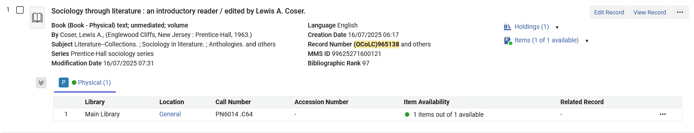
The works in which the short story exists
Here is “Sociology through literature : an introductory reader / edited by Lewis A. Coser”. System control number (OCoLC)965138

Slide 9
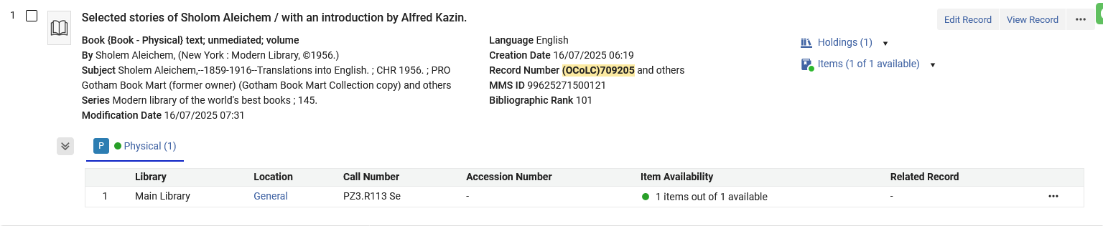
The works in which the short story exists
Here is “Selected stories of Sholom Aleichem / with an introduction by Alfred Kazin”. System control number (OCoLC)709205

Slide 10
Catalog the short story and link to related records

Slide 11
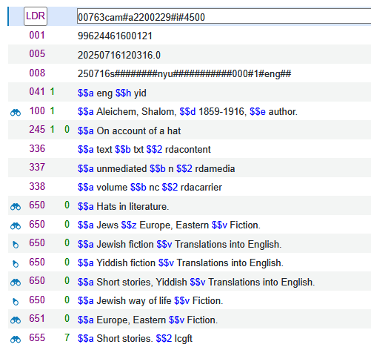
Catalog the short story and link to related records
We have catalogued the bibliographic record. We are not adding any inventory to this record.

Slide 12
Catalog the short story and link to related records
Now we will add 774 fields to link the record to the two related records which we already saw:
Sociology through literature : an introductory reader / edited by Lewis A. Coser. System control number (OCoLC)965138
Selected stories of Sholom Aleichem / with an introduction by Alfred Kazin. System control number (OCoLC)709205

Slide 13
Catalog the short story and link to related records
These are the two fields we will add:
7740_ $$t Sociology through literature : an introductory reader $$w (OCoLC)965138
7740_ $$t Selected stories of Sholom Aleichem $$w (OCoLC)709205
Here we put the title in subfield t and the system control number in subfield w.
We could instead have put the MMSID in subfield w.
If there was an ISBN or ISSN in the related records, then we could have also added the ISBN in subfield z or the ISSN in subfield x
We could also use a subfield g to point to a specific item, such as “Vol. 2” or a specific barcode. This is irrelevant for our situation.

Slide 14
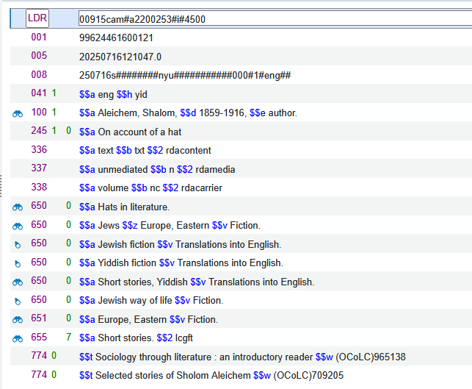
Catalog the short story and link to related records
We have catalogued the 774 Constituent Unit Entry fields

Slide 15
The job "MMS - Build Record Relations"

Slide 16
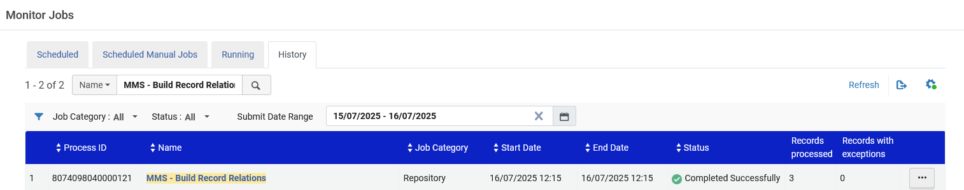
The job "MMS - Build Record Relations"
The regular scheduled job MMS - Build Record Relations runs and completes successfully.
This job creates relationships between MMS (bibliographic) records.

Slide 17
The related records in Alma

Slide 18
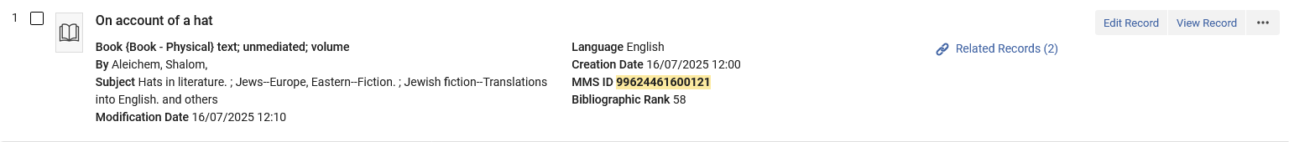
The related records in Alma
A repository search in Alma shows that title “On account of a hat” has two related records:
As we see this record does not have its own inventory. If there was inventory for this record, we would see it here.

Slide 19
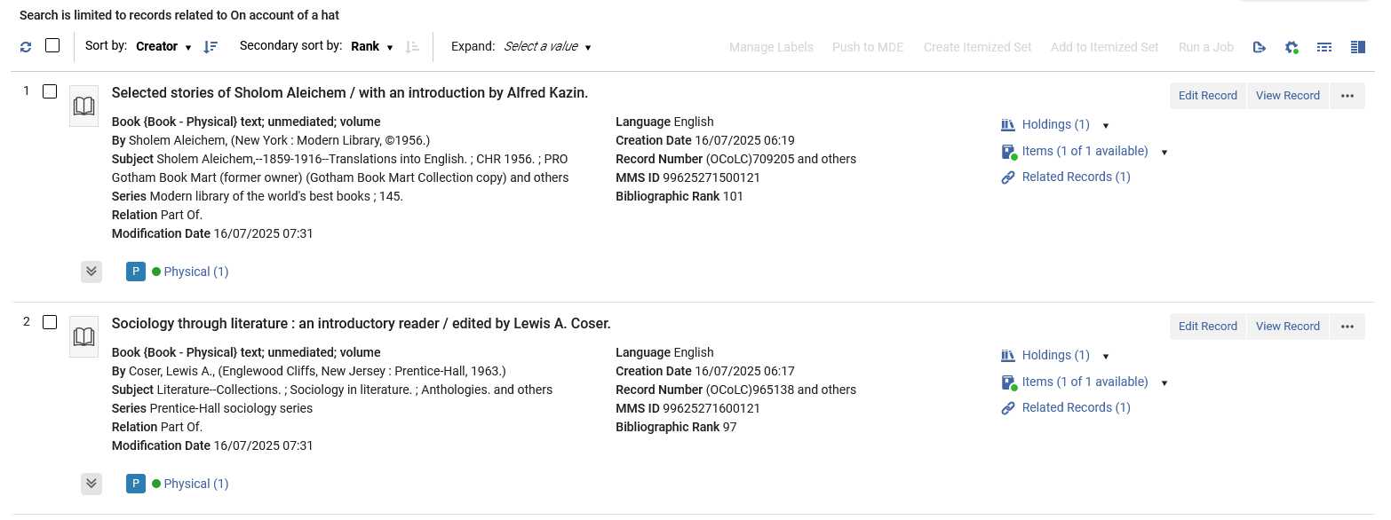
The related records in Alma
Clicking the “Related records” link brings us to the related records
We also have a link back to the short story from each of the related records

Slide 20
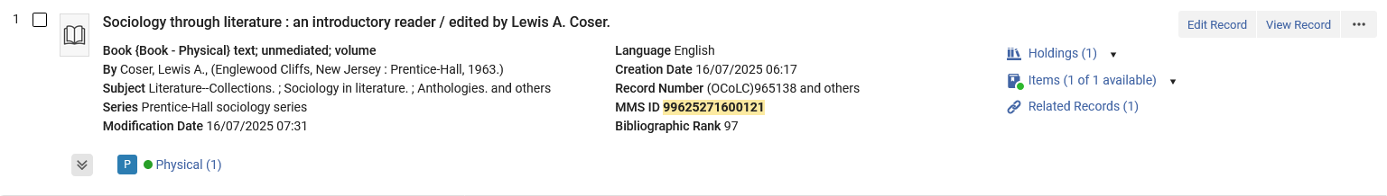
The related records in Alma
Here we have searched for “Sociology through literature : an introductory reader“. We see the link to the related record.
We will click the link to the related records

Slide 21
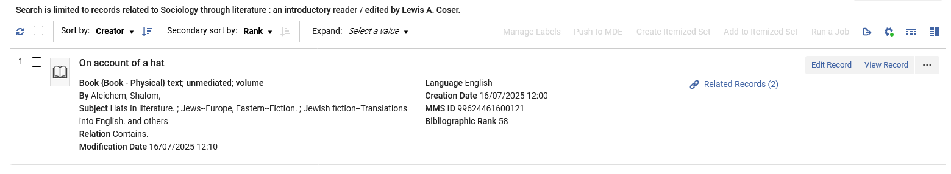
The related records in Alma
We arrive to the related record “On account of a hat”

Slide 22
The related records in discovery (Primo)

Slide 23
The related records in discovery (Primo)
On the next slide we see that the user has searched for title “On account of a hat”.
The results include
  The record for the short story “On account of hat”
  The constituent unit entry “Sociology through literature : an introductory reader ”
  The constituent unit entry “Selected stories of Sholom Aleichem ”.

Slide 24
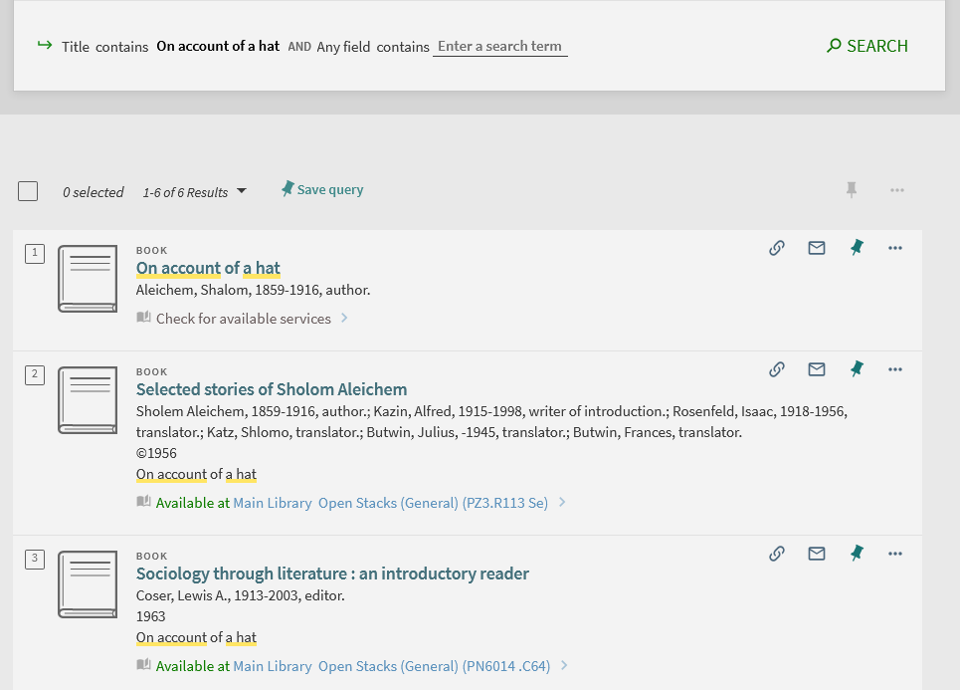
The related records in discovery (Primo)
We will click the title “On account of a hat”

Slide 25
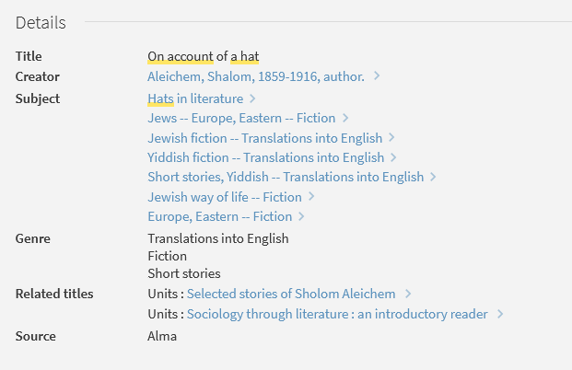
The related records in discovery (Primo)
The display for “On account of a hat” provides links to each of the related titles
We will click the title “Selected stories of Sholom Aleichem”

Slide 26
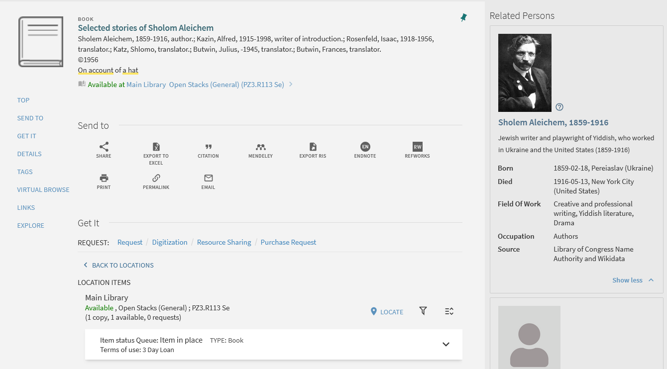
The related records in discovery (Primo)
The user in discovery is brought to the related title and can see inventory information.

Slide 27
Thank You

